Slide 1
An opportunity to reimagine distribution

Slide 2
Imagine a world where visitors can discover every corner of everywhere.
They can book their trip on any device, at any time, on any channel because there is frictionless trade between all parties in the market.
An open and connected market will unlock the full potential in our tourism economy.
This is why TXGB exists.

Slide 3
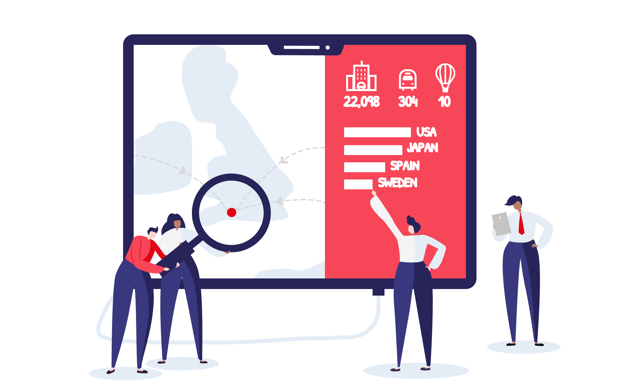
We need to link campaigns to conversion at every level
In Britain we have the most diverse range of authentic experiences anywhere in the world.
Although we do a lot to bring this to life, unless it is bookable online, the digital consumer moves on… and the opportunity is lost.
Our diversity, our authenticity, the value we have at a grass roots level - leads to fragmentation, where the long tail is often not digitally enabled and distributed.

Slide 4
TXGB is a digital marketplace created in partnership with VisitBritain to help suppliers across the UK reach more consumers and enable destinations to conduct smarter marketing campaigns, in order to grow the economy
Smart & Effective
Destination Marketing

Slide 5
Open to all
TXGB can enable bookable content for any business
Accommodation
Attractions
Tours
Experiences
Events
Restaurants
(Coming soon)
Products
(Coming soon)

Slide 6
Direct bookings via your local Destination Websites

Slide 7
We have connected with over 70 booking systems, and are connecting more all the time.
We’re working with to deliver the largest source of bookable product in the UK.

Slide 8
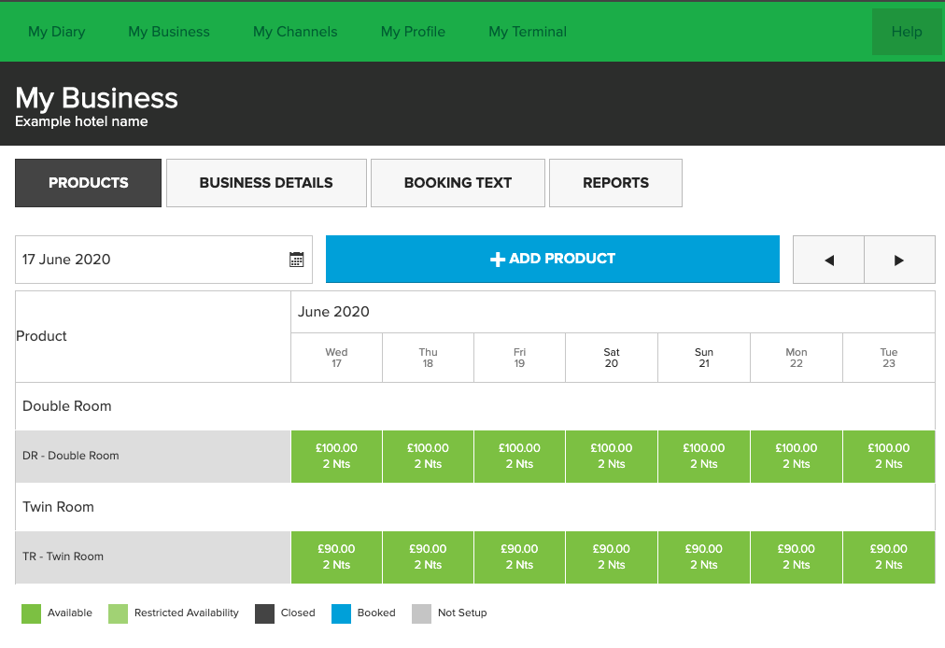
T Load
Option of a free to use tool to manage your pricing, availability and content directly within TXGB simply and easily

Slide 9
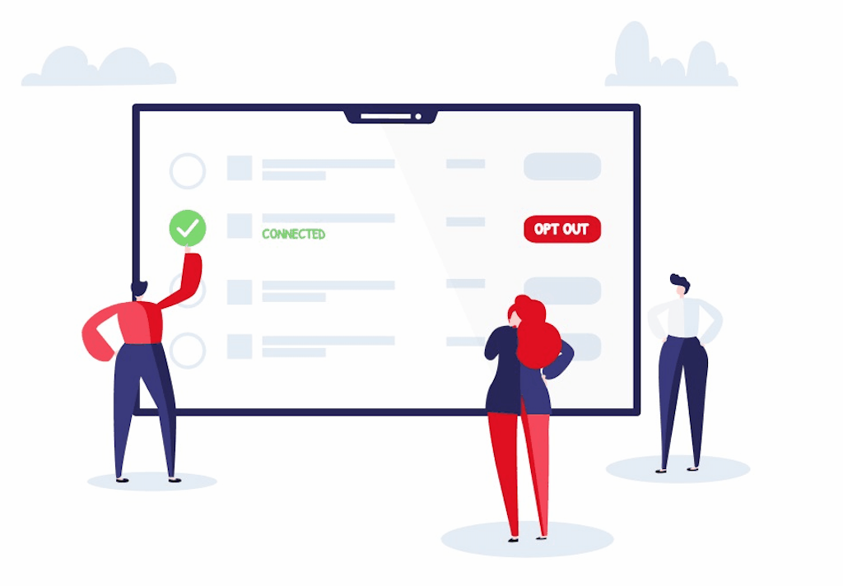
Accommodation
Enhancing the current opportunity for availability searching and direct bookings on Cotswolds.com
Limited direct to PMS bookings via polling engine (SuperControl, Freetobook or Eviivo)
Alternatives are affiliate links via Booking.com, Expedia or Hotel Planner
TXGB integration increases opportunity for direct bookings
Examples Product Page & ‘Quick Book’ via Search from another DMO website
Bookings are made on the Cotswolds Tourism website, maximising the chance of conversion
Take advantage of low 2.5% commission channels, which is given back directly to the DMO team

Slide 10
Accommodation
Coming soon
T Load
Coming soon

Slide 11
“Things to do”
Integrate your bookability with live product availability/pricing and return bookings for the first time.
Bookings are made on the Cotswolds Tourism website, maximising the chance of conversion
Opportunities are not limited to traditional tourism products e.g. coach parking, golf tee times, Local Authority ran products, Beach Huts, events…. Anything with availability and prices!
Example from another DMO website
Take advantage of low 2.5% commission channels, which is given back directly to the DMO team

Slide 12
“Things to do”
T Load

Slide 13
Direct Payments
Our direct payment model means:
Direct transactions between you and the consumer
Payment up front, improving cash flow
Full ownership of your customer data
Your own booking terms
Enables distributors to reduce commission rates

Slide 14
TXGB is already connected to over 120 distributors, of all shapes and sizes, with a simple opt-in process
40+ Destinations
Global OTAs
Alternative
Channels
(Available 2021)

Slide 15
How do I join?
Joining TXGB is quick and easy, and we’re here to help you every step of the way
Claim Your Business
Get Connected
Take Bookings
It’s easy to join. You can connect via your booking system, or directly via TX Load.
It’s free to connect. TXGB will not charge anything until you start generating bookings and there are no monthly fees. TXGB has a 2.5% per booking transaction cost.
Complete application on www.txgb.co.uk
Receive login details to the TXGB Dashboard
Opt in to channels that are right for you
Opportunity to have booking pages to your own website
Diversify your distribution to access more consumers and optimise commissions paid
Receive more bookings
In most cases, receive payment up front and immediately
TXGB will invoice you monthly for any transaction and distribution fees owed

Slide 16
An opportunity to reimagine distribution

Slide 17
Dan Simmons
Head of Growth & Partnerships dan.simmons@txgb.co.uk
Our team is here to help
0330 223 5050
hello@txgb.co.uk

